Slide 1
House Price Prediction using Linear Regression
Machine Learning Project Presentation

Slide 2
Project Objective
Predict house prices using machine learning
Analyze housing data such as area, bedrooms, bathrooms, and city
Build a Linear Regression model to estimate house prices

Slide 3
Tools and Technologies
Python
Pandas
NumPy
Matplotlib
Scikit-learn
Jupyter Notebook / Google colab

Slide 4
Dataset Description
The dataset includes information about houses such as:
Area of the house
Number of bedrooms
Number of bathrooms
City or location
Price of the house

Slide 5
Data Preprocessing
Loaded dataset using Pandas
Checked missing values
Removed duplicate records
Converted categorical values using Label Encoding
Prepared features and target variables

Slide 6
Machine Learning Model
Used Linear Regression algorithm
Split dataset into training and testing data
Trained the model using training data
Predicted house prices using test data

Slide 7
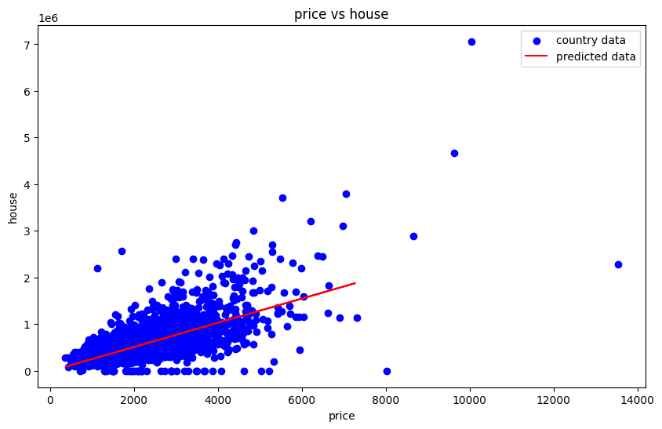
House Price Prediction using Linear Regression

Slide 8
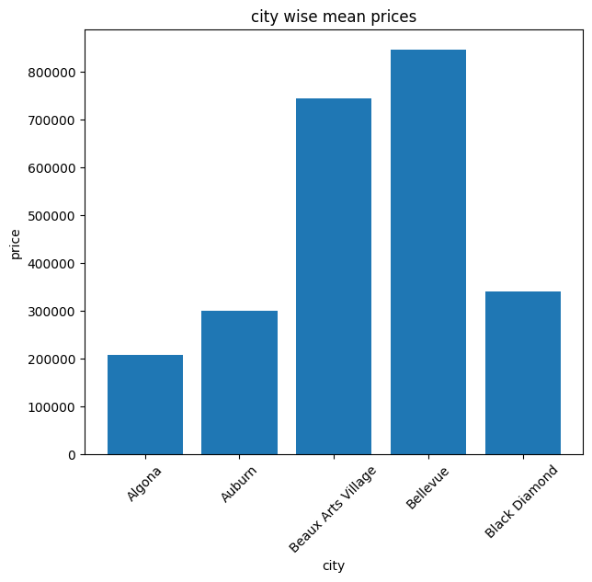
City-wise Mean House Prices

Slide 9
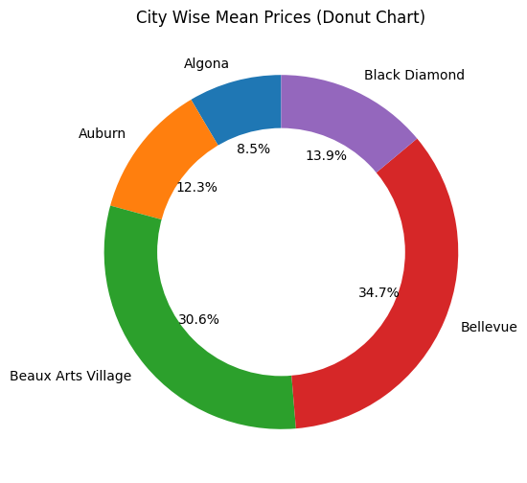
City Wise Mean Prices (Donut Chart)

Slide 10
Results
The model successfully predicts house prices
Strong relationship observed between area and price
Visualization helps understand price patterns

Slide 11
Conclusion
Linear Regression can effectively predict house prices
Data preprocessing improves model performance
Visualization helps understand housing trends

